Slide 1
Chapter 9
Part 2

Slide 2
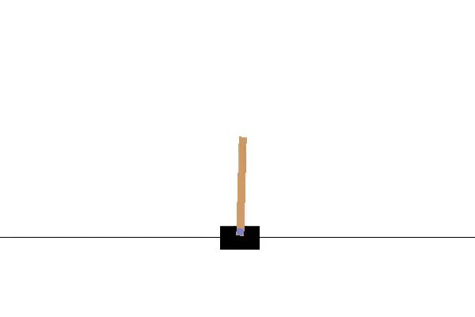
9.5 Feature Construction for Linear Methods
因为线性方法能够保证回归，而且在现实中计算效率也比较高。
也正因为是线性方法，所以在特征的选取和表征上需要人为的选择。
例如平衡木棍的游戏中，你可以选择角速度和位置作为特征，而角速度和位置之间也有关系。

Slide 3
9.5 Feature Construction for Linear Methods
Polynomials
Fourier Basis
Coarse Coding
Tile Coding
Radial Basis Functions

Slide 4




9.5 Feature Construction for Linear Methods
Polynomials
d个维度的特征，可以组成的线性基表示为
例如两维特征 可以组合成的线性基为
高维度线性方程可以用来近似更复杂的函数。但N越大，线性基就更大。可以利用先验知识缩减，也可以使用一些自动的方法缩减。

Slide 5


9.5 Feature Construction for Linear Methods
Fourier Basis
周期函数可以通过sin和cos函数来表征。但Konidaris, Osentoski, and Thomas (2011)发现傅里叶基可以使用在RL中，要表征的函数也不一定要是周期函数。
例如一个特征s可以通过 映射到另一个维度中。
N阶傅里叶余弦基会有 个基，其中d为本身s的维度。

Slide 6
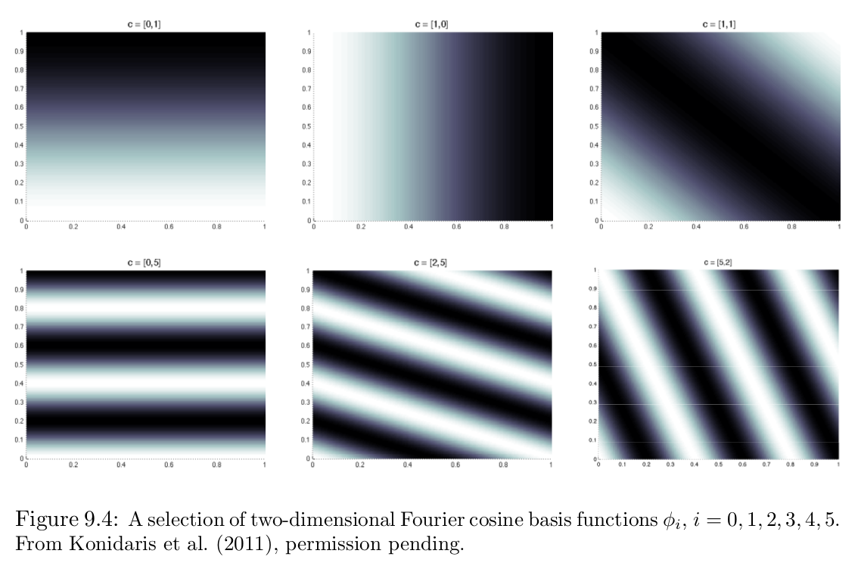
9.5 Feature Construction for Linear Methods
Fourier Basis
例如书上的两个特征，5维度的傅里叶余弦基示例
基于傅里叶基的方法会在不连续的点附近出现震荡，除非引入非常高频的基函数

Slide 7
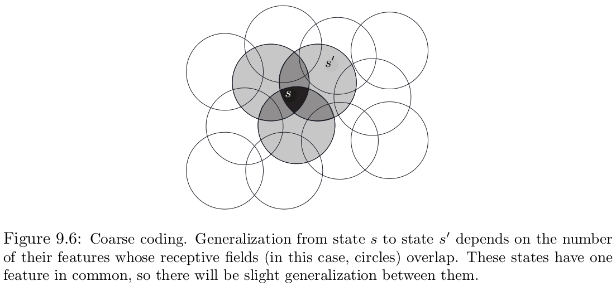
9.5 Feature Construction for Linear Methods
Coarse Coding
如果是state可以表示为二维的空间中的一个点，就可以用圆圈来表示点是不是在圆圈中。

Slide 8
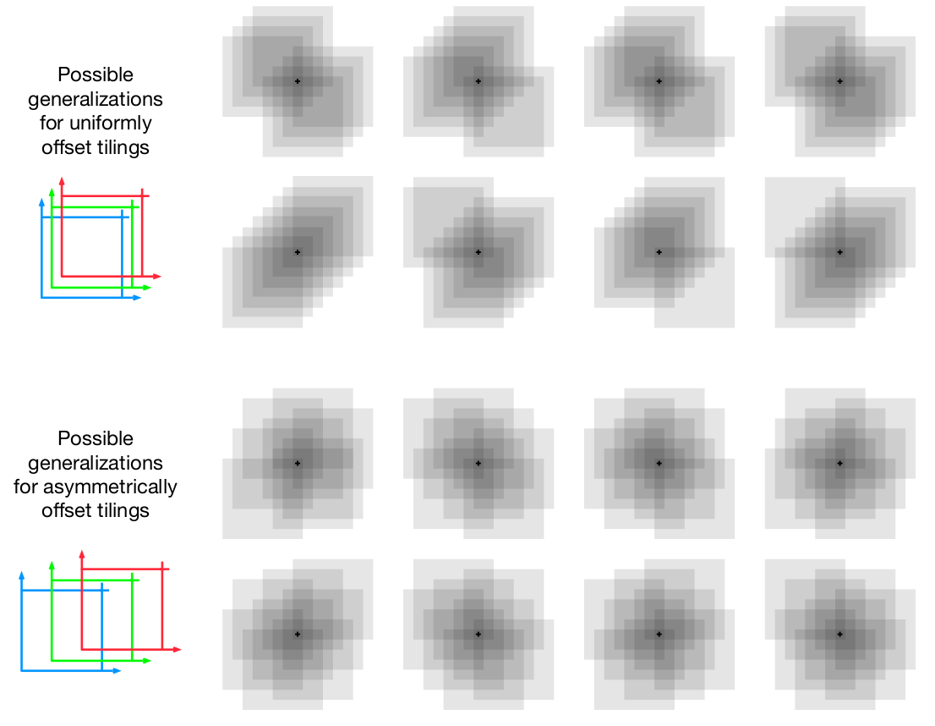
9.5 Feature Construction for Linear Methods
Tile Coding
图中显示的是为什么每个方块需要使用不对称的偏差

Slide 9
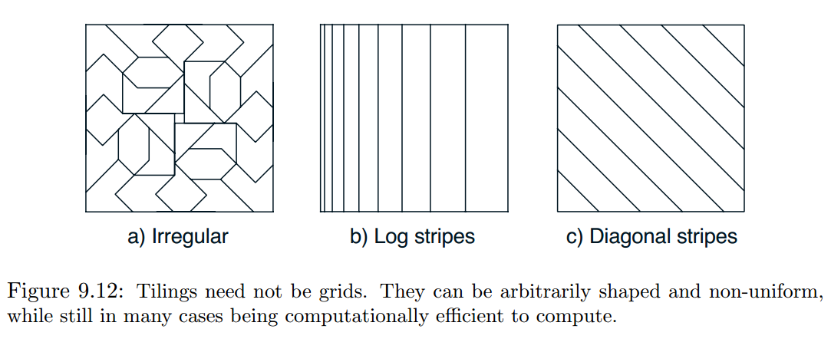
9.5 Feature Construction for Linear Methods
Tile Coding
每个tile也不一定是方形的,可以有多种形状

Slide 10
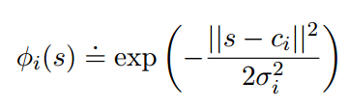
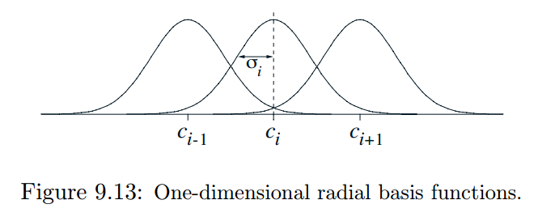
9.5 Feature Construction for Linear Methods
Radial Basis Functions
映射到高斯核函数上
计算复杂,通常需要手动调整参数

Slide 11
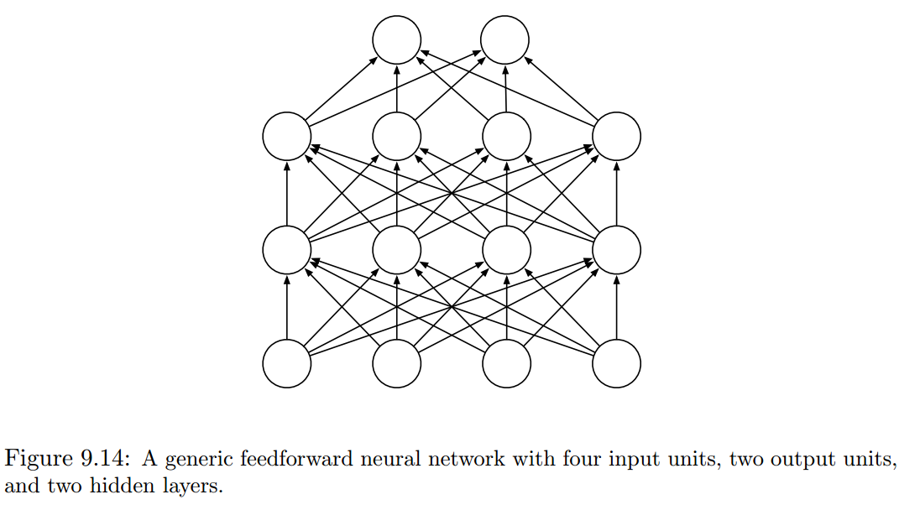

9.6 Nonlinear Function Approximation: Artificial Neural Networks
nonlinearity is essential: if all the units in a multi-layer feedforward ANN have linear activation functions, the entire network is equivalent to a network with no hidden layers

Slide 12
9.6 Nonlinear Function Approximation: Artificial Neural Networks
In Section 15.10 we discuss methods for training ANNs with hidden layers that use reinforcement learning principles instead of backpropagation. These methods are less efficient than the backpropagation algorithm, but they may be closer to how real neural networks learn.
difficult to avoid the problem of overfitting 原因:数据太少 方法:Dropout
backpropagation does not work well for deep ANNs

Slide 13
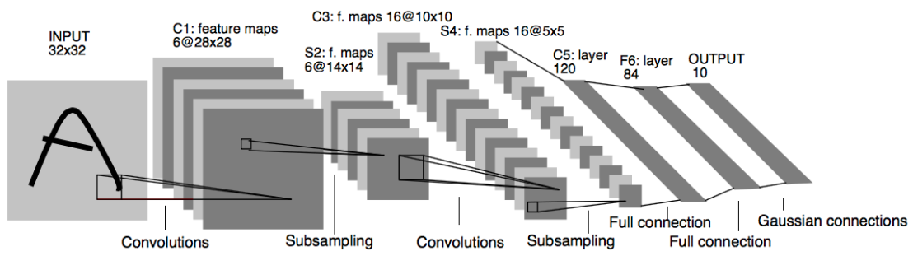
9.6 Nonlinear Function Approximation: Artificial Neural Networks

Slide 14
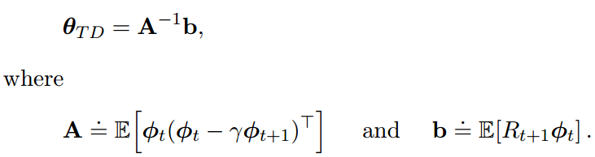
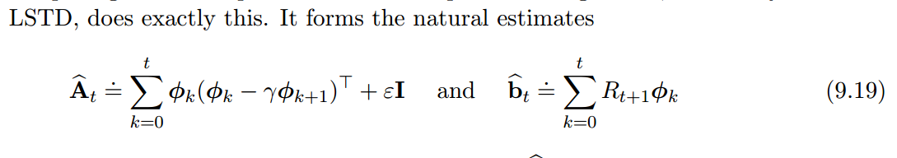
9.7 Least-Squares TD

Slide 15
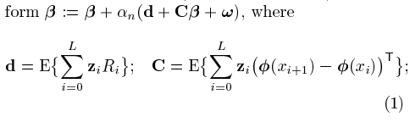
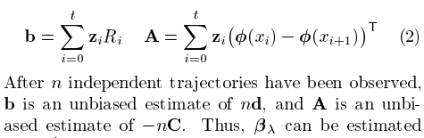
9.7 Least-Squares TD

Slide 16
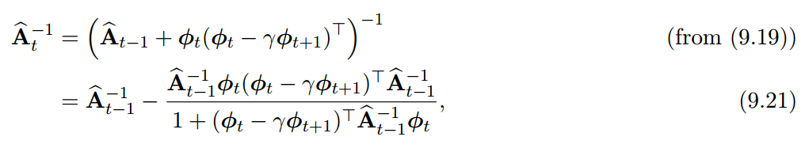
9.7 Least-Squares TD
the computational complexity of a general inverse computation is O(n3)
Can also be updated incrementally with only O(n2) computations, as
if is chosen too small the sequence of inverses can vary wildly, and if is chosen too large then learning is slowed
https://en.wikipedia.org/wiki/Woodbury_matrix_identity

